Slide 1
ZENTANGLES

Slide 2
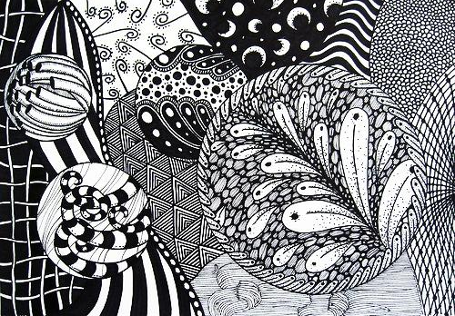
WHAT IS A ZENTANGLE?
A Zentangle is a form of artistic meditation that uses repetitive patterns to create images.

Slide 3
ABOUT THE ZENTANGLE
ABOUT:
The Zentangle increases focus and creativity, provides artistic satisfaction along with an increased sense of personal well being.
The Zentangle method is enjoyed all over this world across a wide range of skills, interests and ages.

Slide 4
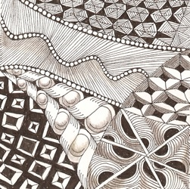
BENIFITS OF DOODLING
Doodling could help the mind remain alert during dull tasks.
http://www.ted.com/talks/sunni_brown.htmlRelaxation
Idea generator

Slide 5
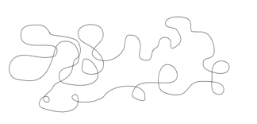
ZENTANGLE STEP 1
Begin by drawing a continuous line in any direction you wish but end up at the very beginning so the line encloses a shape.

Slide 6
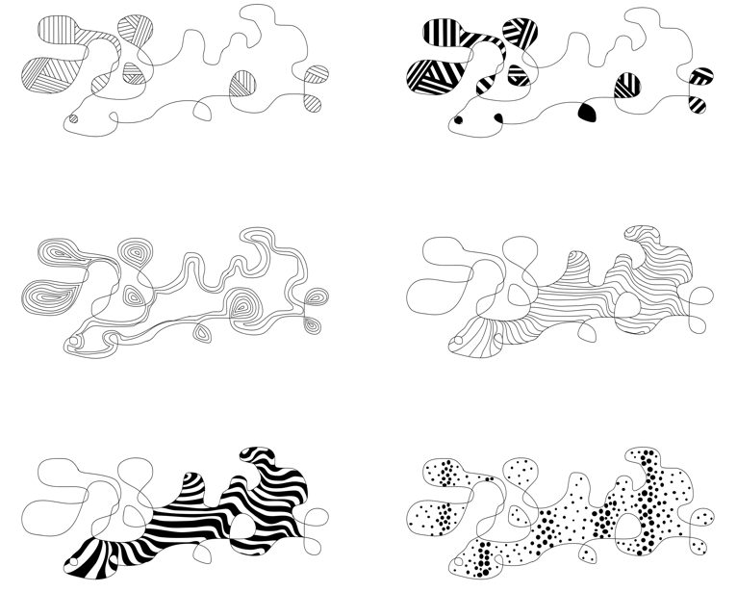
ZENTANGLE STEP 2
Next, decorate your doodle.
(here are a few examples: patches, concentric, dots, pinwheel, cactus, shaded edge, stretched checkerboard)

Slide 7
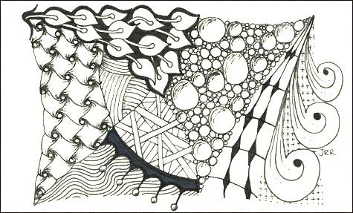
ZENTANGLE STEP 3
Continue to add value. Make sure to repeat some of the patterns more than once. THIS IS KNOWN AS REPETITION.
See where your tangle takes you, don’t overthink it.

Slide 8
INCLUDE LINE VARIATION
Thin to wide!
Light to dark,
Big or small!
Curver to straight!
Solid to patterned!
…………………….and so on

Slide 9
HOW WILL YOUR ZENTANGLE TURN OUT?

Slide 10
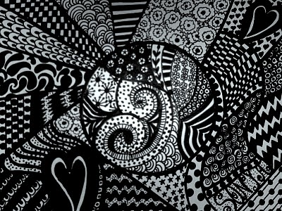
ZENTANGLE

Slide 11
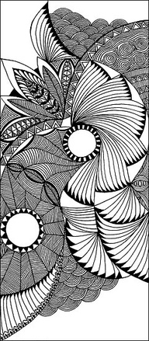
ZENTANGLE

Slide 12
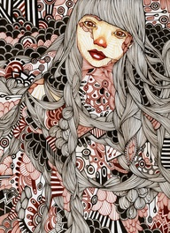
HOW CAN YOU USE THIS IDEA IN OTHER WORKS OF ART?

