Slide 1
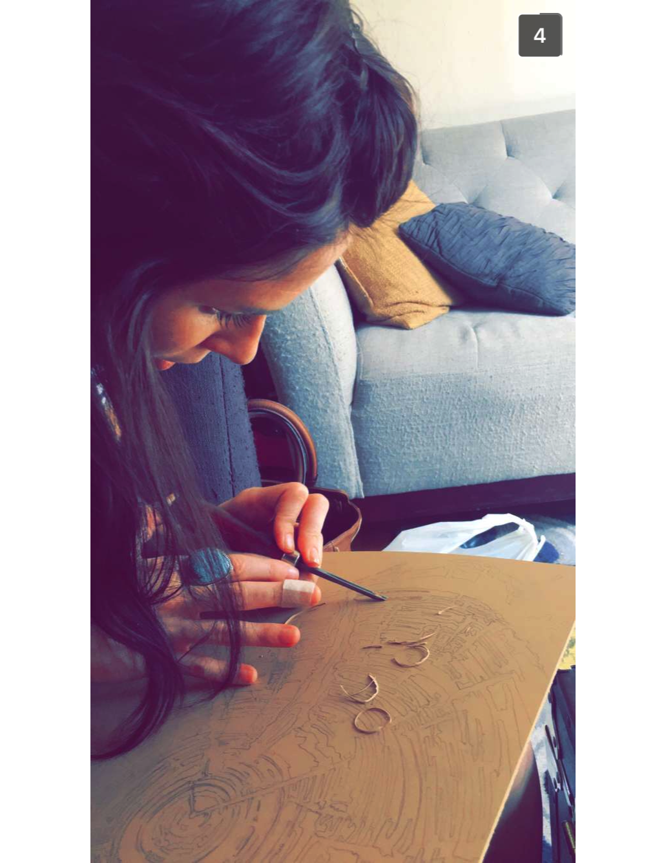
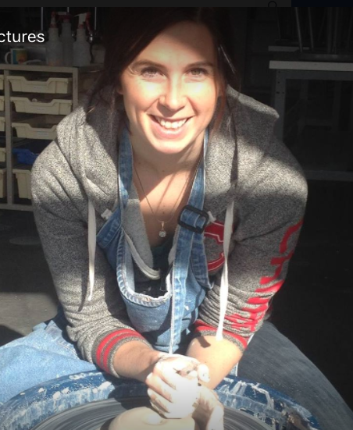
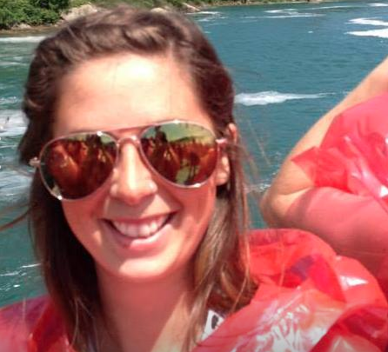
WHO IS TEACHING YOU ART??
FIRST….....LET”S LEARN SOME SIGN LANGUAGE!

Slide 2
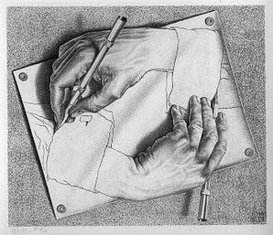
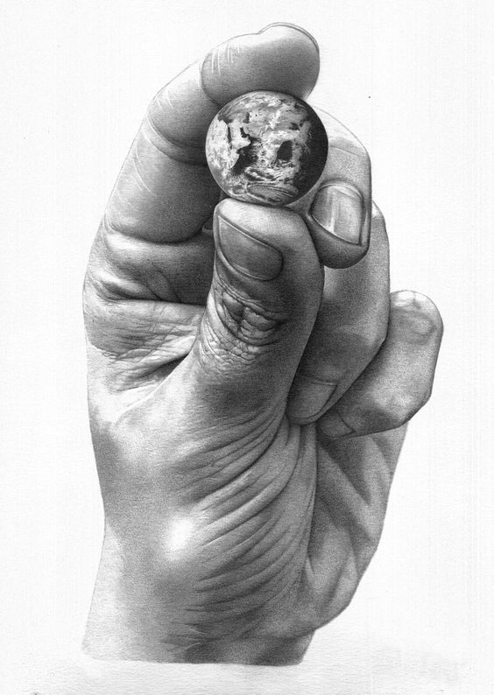
Which art work did Ms. Acker do?
A
C
B

Slide 3
Ms. Acker has an art degree but what other degree does she have????
A) Interior Design
B) Math Education
C) Family and Couples Counseling
D) Architecture

Slide 4
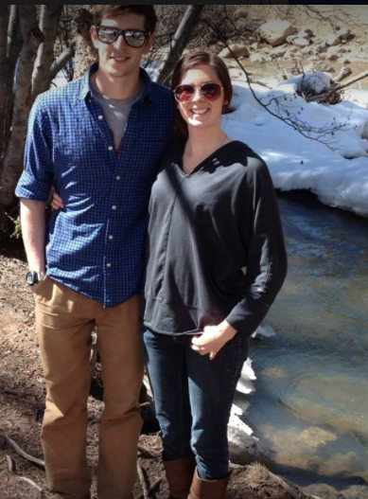
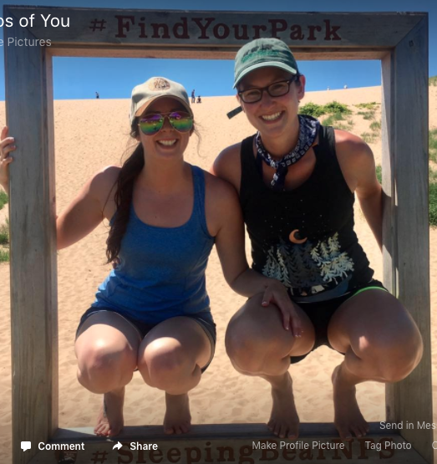
Who are the people in these photos?

Slide 5
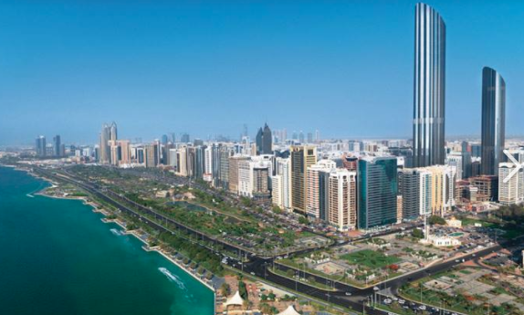
How many countries has Ms. Acker been to?
A) 1, This one
B) Over 15
C) All of them!
D) Over 100

Slide 6
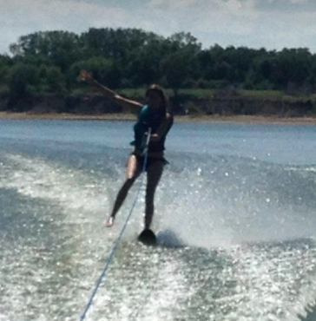
What is Ms. Acker’s Spirit animal?
A) Hungry Hippo
B) Jelly Fish
C) Alligator
D) Humming bird

Slide 7
Any Questions for me?

