Slide 1
Your only task is to write down what color each word is written in.
There are 10 questions in total ☺

Slide 8
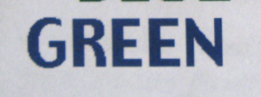

Slide 12
Let’s see how you did. ….
Answer key:
1. RED
2. BLUE
3. RED
4. BLACK
5. RED
6. Green
7. Blue
8. Yellow
9. Green
10. Blue

Slide 13
LET’s TRY one more time ☺
READY!?!?!?!

Slide 24
DID YOU IMPROVE???
1. Green
2. Red
3. Blue
4. Green
5. Red
6. Black
7. Red
8. Blue
9. Yellow
10.Blue

